Slide 1
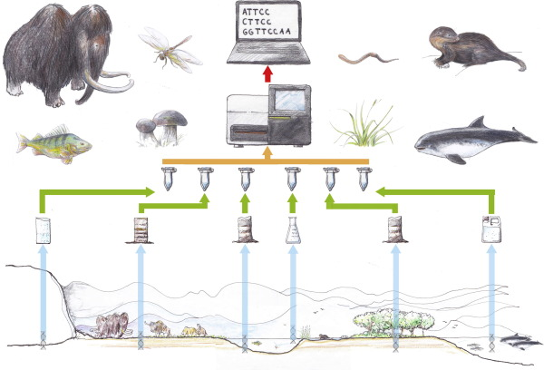
EEOB 8896.09 Current Topics in Environmental DNA (eDNA) Dr. Roman Lanno lanno.1@osu.edu SP22 (#22534) 1 credit hour Jennings Hall, Rm 160 Wednesdays 4-4:50pm
What is environmental DNA (eDNA) and what are its applications in environmental toxicology, ecology, and conservation biology?
Examine and discuss the fundamentals of sampling, experimental design, data analysis, the applications and limitations of this technology
Explore recent topics such as passive samplers in collecting eDNA and potential applications of eRNA
This seminar is not about metagenomics, but rather examines eDNA from invertebrates and vertebrates, either for species-specific or metabarcoding applications

